Slide 1

Fall
3
Key Ideas and Details and Transformations
Stuy Prep
Lesson 26F3
Notes:
Slide designed by Benjamin Xie. Logo designed by Madeleine Villamil.

Slide 2
Homework
Does anyone have questions on 26F2 Homework: Phrases and Clauses and Irrational Numbers and Circles?
₊✩‧₊˚౨ৎ˚₊✩‧₊ ✮ ⋆ ˚｡⋆｡°✩⋆˚˖°
Notes:
Slide designed by Amy Shrestha & Benjamin Xie. Logo designed by Madeleine Villamil.

Slide 3
theme central idea “cite evidence” (30) diagram
Fall
3
English Language Arts
Key Ideas and Details
Aim: Use cited textual evidence and connections with visual media to analyze the development of themes and central ideas.
Do Now: Why is it so important to cite evidence?
theme central idea “cite evidence” (30) diagram
Notes:
Text from English Language Arts Learning Standards. Slide designed by Benjamin Xie.

Slide 4
Citing Evidence
Evidence can include:
- a direct quotation
- a specific detail
- an action or event
- information stated by the author
Your answer should never come from a guess alone!
Think: Answer → Find it → Prove it
When answering a question about a text, your answer should be supported by evidence from the passage.
theme central idea “cite evidence” (30) diagram
Notes:
Standard approximation: 8R1
Slide designed by Benjamin Xie. Logo designed by Madeleine Villamil.

Slide 5
Citing Evidence: Find the Proof
Before choosing an answer:
1. Read the question carefully.
2. Come up with an answer in your own words.
3. Go back to the passage.
4. Find the sentence or detail that proves your answer.
5. Choose the answer choice that best matches that evidence.
If you cannot find evidence for an answer, reconsider it!
Citing Evidence
On the SHSAT, the correct answer must be supported by the text.
theme central idea “cite evidence” (30) diagram
Notes:
Standard approximation: 8R1
Slide designed by Benjamin Xie. Logo designed by Madeleine Villamil.

Slide 6
Citing Evidence: Be Specific
Weak evidence:
Maya is getting ready for the performance.
Strong evidence:
Before going onstage, Maya's hands shake and she repeatedly checks the curtain.
The second detail is stronger because it directly shows nervousness.
Remember: Find the evidence that most directly answers the question.
What Counts as Strong Evidence?
Strong evidence directly supports the claim you are making.
Claim: Maya is nervous about performing.
theme central idea “cite evidence” (30) diagram
Notes:
Standard approximation: 8R1
Slide designed by Benjamin Xie. Logo designed by Madeleine Villamil.

Slide 7
Progress Check: Where's the Evidence?
Which detail BEST supports the idea that Jordan is persistent?
A. The model is unfinished.
B. One side leans downward.
C. He has rebuilt the model twice and begins measuring again.
D. He sighs while looking at the model.
A passage says:
Jordan stared at the unfinished model. He had already rebuilt it twice, but one side still leaned downward. He sighed, picked up the ruler, and began measuring again.
theme central idea “cite evidence” (30) diagram
Notes:
Answer: C
Why? It shows that even after failing more than once, Jordan continues working.

Slide 8
Themes and Central Ideas
Look for:
- important events
- new information
- conflicts or problems
- character choices
- repeated ideas
- changes from the beginning to the end
Ask: What does each part of the text add to the idea?
We already know how to identify a theme or central idea.
Now, focus on:
How does it develop?
A theme or central idea usually becomes clearer as the text continues.
theme central idea “cite evidence” (30) diagram
Notes:
Standard approximation: 8R2
Slide designed by Benjamin Xie. Logo designed by Madeleine Villamil.

Slide 9
Development of a Theme
For example:
Beginning: A character refuses help because she wants to solve every problem alone.
Middle: She struggles and realizes that refusing help makes the problem worse.
End: She accepts help from a friend and succeeds.
Theme: Asking others for help can be a sign of strength rather than weakness.
Each event helps build toward the theme.
How Does a Theme Develop?
A theme develops through the details and events of the text.
theme central idea “cite evidence” (30) diagram
Notes:
Standard approximation: 8R1
Slide designed by Benjamin Xie. Logo designed by Madeleine Villamil.

Slide 10
Development of a Central Idea
Example
Central Idea: Urban trees improve city environments.
Paragraph 1 → explains how trees provide shade
Paragraph 2 → describes how they reduce air pollution
Paragraph 3 → gives evidence that they can lower neighborhood temperatures
Each paragraph adds another piece of evidence or explanation to develop the central idea.
How Does a Central Idea Develop?
In informational texts, authors develop a central idea by adding:
- facts
- examples
- explanations
- statistics
- causes and effects
- comparisons
theme central idea “cite evidence” (30) diagram
Notes:
Standard approximation: 8R1
Slide designed by Benjamin Xie. Logo designed by Madeleine Villamil.

Slide 11
Visual Text
Visuals may include:
- graphs
- charts
- diagrams
- maps
- timelines
- photographs
- illustrations
Do NOT treat the visual as something separate.
Ask: What information does the visual add to the text?
Some questions include both written text and a visual.
theme central idea “cite evidence” (30) diagram
Notes:
Standard approximation: 6R9
Slide designed by Benjamin Xie. Logo designed by Madeleine Villamil.

Slide 12
Reading a Visual
Before connecting a visual to the passage, figure out what the visual is actually showing.
1. Identify the visual.
Is it a graph? Diagram? Map? Chart?
2. Read everything. Check:
- title
- labels
- axes
- key/legend
- captions
- units
3. Notice the important pattern.
What increases? Decreases? Changes? Stays the same?
4. Return to the text.
Which statement or idea does the visual support, clarify, or add to?
Never ignore labels or units!
theme central idea “cite evidence” (30) diagram
Notes:
Standard approximation: 6R9
Slide designed by Benjamin Xie. Logo designed by Madeleine Villamil.

Slide 13
Text + Graph Example
Graph:
Year | Number of Trees | Average Temperature
1 | 5 | 91°F
3 | 14 | 88°F
5 | 25 | 84°F
Text:
A school added more trees to its courtyard over five years. During the same period, average summer temperatures in the courtyard decreased.
What does the graph add to the text?
It provides specific numerical evidence showing that as the number of trees increased, the average temperature decreased.
Key Idea: The text makes a claim. The visual can provide additional evidence for that claim.
theme central idea “cite evidence” (30) diagram
Notes:
Standard approximation: 6R9
Slide designed by Benjamin Xie. Logo designed by Madeleine Villamil.

Slide 14
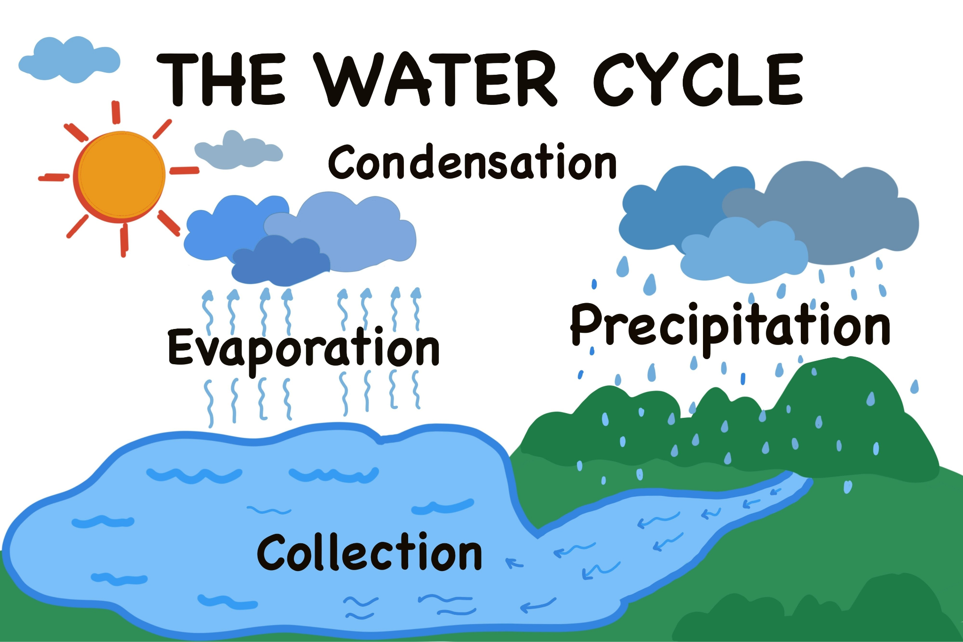
Text + Diagram Example
Text:
Water evaporates from Earth's surface, cools and condenses into clouds, and eventually falls back to Earth as precipitation.
Diagram:
What does the diagram add?
The text describes the process.
The diagram helps the reader see the order and relationship between the stages.
Visuals can: support • clarify • organize • provide additional information
theme central idea “cite evidence” (30) diagram
Notes:
Standard approximation: 6R9
Slide designed by Benjamin Xie. Logo designed by Madeleine Villamil.

Slide 15
Progress Check
1. Citing Evidence
What should you do before choosing an answer about a passage?
2. Theme/Central Idea
What should you pay attention to when asked how a theme or central idea develops?
3. Visual Text
When a passage includes a graph or diagram, what should you ask?
FIND THE EVIDENCE.
FOLLOW HOW THE IDEA DEVELOPS.
CONNECT THE VISUAL TO THE TEXT.
theme central idea “cite evidence” (30) diagram
Notes:
1. Citing Evidence
What should you do before choosing an answer about a passage?
Find evidence in the text that supports it.
2. Theme/Central Idea
What should you pay attention to when asked how a theme or central idea develops?
How details, events, or information build the idea throughout the text.
3. Visual Text
When a passage includes a graph or diagram, what should you ask?
What information does the visual add to, support, or clarify in the text?

Slide 16
→ ↺ reflect ≅ dilate ~ translate rotate ⇆ congruence ↗︎ similarity
Fall
3
Mathematics
Transformations
Aim: Develop various modeling strategies to understand and represent situations as geometric transformations.
Do Now: What does it mean to transform something? (Not math-related; just in life.)
→ ↺ reflect ≅ dilate ~ translate rotate ⇆ congruence ↗︎ similarity
Notes:
Slide designed by Benjamin Xie.

Slide 17
Translations, Rotations, and Reflections
A translation displaces every point in the plane by the same distance (in the same direction) and can be described using a vector (directed line segment).
→ ↺ reflect ≅ dilate ~ translate rotate ⇆ congruence ↗︎ similarity
Notes:
Standard approximation: NY-8.G.1
Text from New York State Education Department. Slide designed by Benjamin Xie. Logo designed by Madeleine Villamil.

Slide 18
Translations, Rotations, and Reflections
Point A: (−2.5, 1)
Translation: 1 unit up, 2.25 units to the right
Point A’ (A prime):
(−2.5+2.25, 1+1) = (−0.25, 2)
→ ↺ reflect ≅ dilate ~ translate rotate ⇆ congruence ↗︎ similarity
Notes:
Standard approximation: NY-8.G.1, NY-8.G.3
Text from New York State Education Department. Slide designed by Benjamin Xie. Logo designed by Madeleine Villamil.

Slide 19
Translations, Rotations, and Reflections
A rotation requires knowing the center/point of rotation and the measure/direction of the angle of rotation.
Positive measures mean counterclockwise angles of rotation.
→ ↺ reflect ≅ dilate ~ translate rotate ⇆ congruence ↗︎ similarity
Notes:
Standard approximation: NY-8.G.1
Text from New York State Education Department. Slide designed by Benjamin Xie. Logo designed by Madeleine Villamil.

Slide 20
Translations, Rotations, and Reflections
Point B: (−2.5, 0)
Center of rotation: (0, 0)
Angle of rotation: 90°
Point B’: (0, −2.5)
→ ↺ reflect ≅ dilate ~ translate rotate ⇆ congruence ↗︎ similarity
Notes:
Standard approximation: NY-8.G.1, NY-8.G.3
Text from New York State Education Department. Slide designed by Benjamin Xie. Logo designed by Madeleine Villamil.

Slide 21
Translations, Rotations, and Reflections
Point P: (1, 0)
+90° or −270°: (0, 1)
+180° or −180°: (−1, 0)
+270° or −90°: (0, −1)
→ ↺ reflect ≅ dilate ~ translate rotate ⇆ congruence ↗︎ similarity
Notes:
Standard approximation: NY-8.G.1, NY-8.G.3
Text from New York State Education Department. Slide designed by Benjamin Xie. Logo designed by Madeleine Villamil.

Slide 22
Translations, Rotations, and Reflections
A line reflection requires a line and the knowledge of perpendicular bisectors (shortest distance from a point to a line).
→ ↺ reflect ≅ dilate ~ translate rotate ⇆ congruence ↗︎ similarity
Notes:
Standard approximation: NY-8.G.1
Text from New York State Education Department. Slide designed by Benjamin Xie. Logo designed by Madeleine Villamil.

Slide 23
Translations, Rotations, and Reflections
Point C: (−0.5, 0)
Line of reflection: y = −0.5
Point C’: (−0.5, 0+2(−0.5))
= (−0.5, −1)
→ ↺ reflect ≅ dilate ~ translate rotate ⇆ congruence ↗︎ similarity
Notes:
Standard approximation: NY-8.G.1, NY-8.G.3
Text from New York State Education Department. Slide designed by Benjamin Xie. Logo designed by Madeleine Villamil.

Slide 24
Translations, Rotations, and Reflections
Notice that with all of these rigid transformations:
lines are mapped to lines
line segments are mapped to line segments of the same length
angles are mapped to angles of the same measure
parallel lines are mapped to parallel lines
→ ↺ reflect ≅ dilate ~ translate rotate ⇆ congruence ↗︎ similarity
Notes:
Standard approximation: NY-8.G.1
Text from New York State Education Department. Slide designed by Benjamin Xie. Logo designed by Madeleine Villamil.

Slide 25
Congruence
Congruent (≅) line segments are line segments that are equal in measure (length).
Congruent angles are angles that are equal in measure.
A 2D figure is congruent to another if the corresponding angles are congruent and the corresponding sides are congruent.
△ABC ≅ △DEF means D corresponds to A, etc.
→ ↺ reflect ≅ dilate ~ translate rotate ⇆ congruence ↗︎ similarity
Notes:
Standard approximation: NY-8.G.2
Text from Catharine Maitner, New York State Education Department. Slide designed by Benjamin Xie. Logo designed by Madeleine Villamil.

Slide 26
Congruence
Remember, rigid transformations preserve the measures of line segments and angles. You saw in the previous slides how the shape of the triangle stayed the same.
This means that two two-dimensional figures are congruent if one is the image of the other after a sequence of rotations, reflections, and translations.
→ ↺ reflect ≅ dilate ~ translate rotate ⇆ congruence ↗︎ similarity
Notes:
Standard approximation: NY-8.G.2
New York State Education Department. Slide designed by Benjamin Xie. Logo designed by Madeleine Villamil.

Slide 27
Dilations
With dilation, the center and scale factor must be specified.
→ ↺ reflect ≅ dilate ~ translate rotate ⇆ congruence ↗︎ similarity
Notes:
Standard approximation: NY-8.G.3
Text from New York State Education Department. Slide designed by Benjamin Xie. Logo designed by Madeleine Villamil.

Slide 28
Dilations
Point A: (−2.5, 1)
Center of dilation: (−2, −0.5)
Scale factor: 2
A’: (−2+2(−0.5), −0.5+2(1.5))
= (−3, 2.5)
→ ↺ reflect ≅ dilate ~ translate rotate ⇆ congruence ↗︎ similarity
Notes:
Standard approximation: NY-8.G.3
Text from New York State Education Department. Slide designed by Benjamin Xie. Logo designed by Madeleine Villamil.

Slide 29
Similarity
A two-dimensional figure is similar (~) to another if the corresponding angles are congruent and the corresponding sides are in proportion.
Congruent figures are also similar (not the other way around) because if corresponding sides are congruent, they are also in proportion.
→ ↺ reflect ≅ dilate ~ translate rotate ⇆ congruence ↗︎ similarity
Notes:
Standard approximation: NY-8.G.4
Text from Catharine Maitner, New York State Education Department. Slide designed by Benjamin Xie. Logo designed by Madeleine Villamil.

Slide 30
Similarity
Also notice how, after a dilation, corresponding angles are congruent and corresponding sides are in proportion.
This means that two figures are similar if one is the image of the other after a sequence of rotations, reflections, translations, and dilations.
→ ↺ reflect ≅ dilate ~ translate rotate ⇆ congruence ↗︎ similarity
Notes:
Standard approximation: NY-8.G.4
Text from Catharine Maitner, New York State Education Department. Slide designed by Benjamin Xie. Logo designed by Madeleine Villamil.

Slide 31
Fall
3
Thanks for coming! Questions?
Sources: New York State Education Department, Catharine Maitner
Notes:
Slide designed by Benjamin Xie. Logo designed by Madeleine Villamil.

